Slide 1
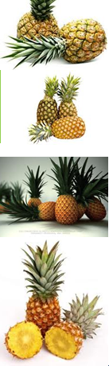
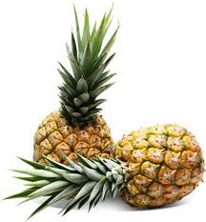
Universidade Federal do Estado do Acre
Centro de Ciências Biológicas da Natureza
Curso de Engenharia Agronômica
Pet- Agronomia
Cultura do Abacaxi
Tutor: José Ribamar
Petiano: Willyan Rodrigues

Slide 2

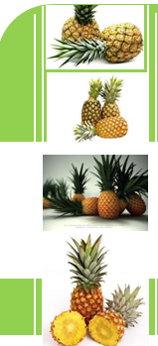
Introdução
Cultura do abacaxi
Brasil;
Brasil;
Mundo;
Nutricional;
Industrial;
Cuidados;
Nutricional;
Mundo;
Industria;
Cuidados.

Slide 3
Clima
Cultura do abacaxi
Brasil;
Rústica e resistente;
Temperatura;
Precipitação pluviométrica;
Umidade relativa do ar;
Nutricional;
Mundo;
Industria;
Cuidados.

Slide 4
Clima
Cultura do abacaxi
Brasil;
Luminosidade;
Fotoperiodismo;
Ventos;
Altitude;
Nutricional;
Mundo;
Industria;
Cuidados.

Slide 5
Cultivares variedades
Cultura do abacaxi
Brasil;
Smooth Cayenne;
Pérola;
Perolera;
Primavera;
Quinari;
Nutricional;
Mundo;
Industria;
Cuidados.

Slide 6
Escolha do local
Cultura do abacaxi
Brasil;
Textura do solo;
Características químicas;
Drenagem do solo;
Topografia;
Nutricional;
Mundo;
Industria;
Cuidados.

Slide 7
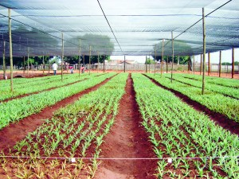
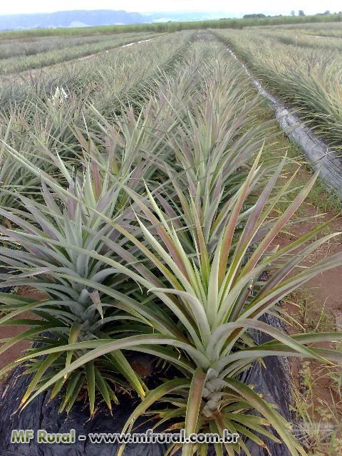
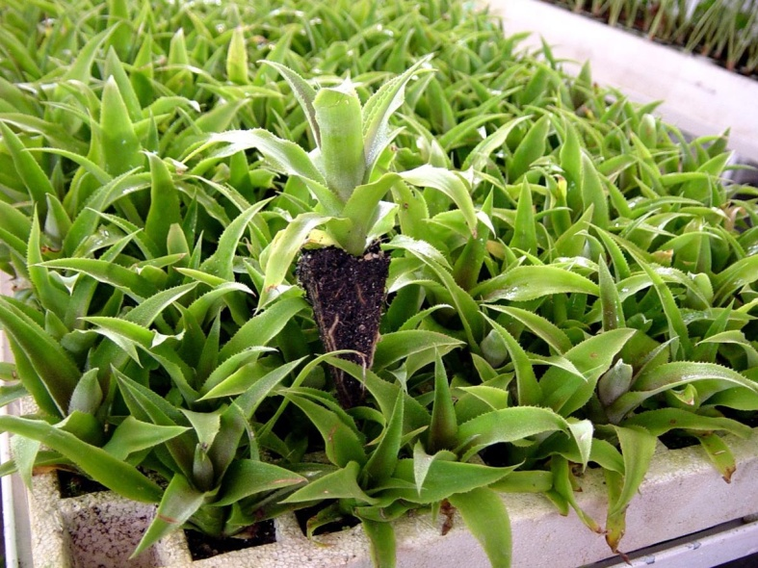
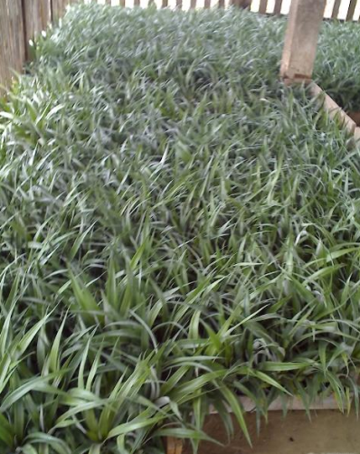
Obtenção de mudas
Cultura do abacaxi
Brasil;
Origem;
Nutricional;
Mundo;
Industria;
Cuidados.

Slide 8
Tipos de mudas
Cultura do abacaxi
Coroa;
Filhote;
Rebentão;
Filhote-rebentão;
Brasil;
Nutricional;
Mundo;
Industria;
Cuidados.

Slide 9
Manejo de mudas
Cultura do abacaxi
Brasil;
Ceva;
Colheita;
Cura;
Seleção;
Tratamento fito sanitário;
Nutricional;
Mundo;
Industria;
Cuidados.

Slide 10
Plantio e espaçamento
Cultura do abacaxi
Brasil;
Método de plantio;
Tipo de plantio | Distância entre filas e plantas (m) | Plantas/h
Filas simples | 0,90 x 0,30 | 37.000
 | 0,80 x 0,30 | 41.600
Filas duplas | 0,90 x 0,40 x 0,40 | 38.460
 | 0,90 x 0,40 x 0,35 | 43.950
 | 0,90 x 0,40 x 0,30 | 51.280
Nutricional;
Mundo;
Industria;
Cuidados.

Slide 11
Adubação
Cultura do abacaxi
Bastante exigente;
Brasil;
Adubação, ciclo;
2°mês (NPK);
5°e 6° mês (NK);
8° e 9° mês (NK);
Nutricional;
Doses usadas na adubação;
Mundo;
Industria;
6 a 10g por planta (N);
1 a 4g por planta para o (P);
4 a 15g por planta para(K);
Cuidados.

Slide 12
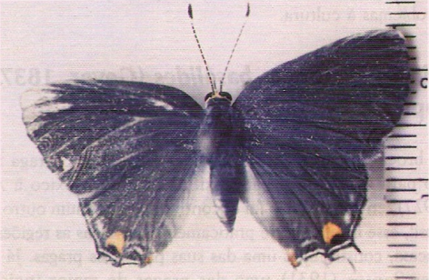
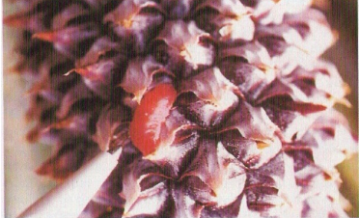
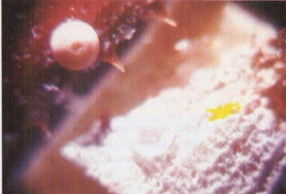
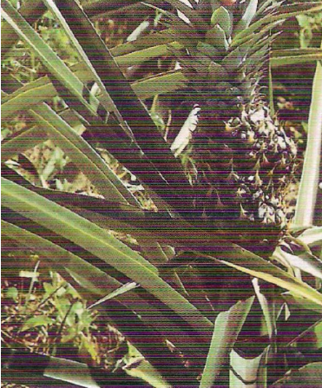
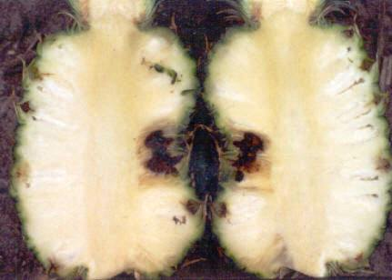
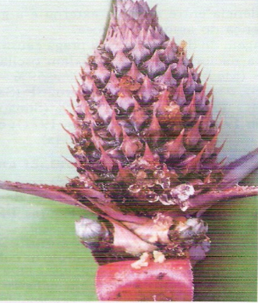
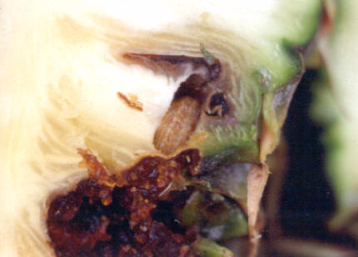
Pragas e doenças
Cultura do abacaxi
Brasil;
Broca do fruto (Thecla
basalides);
Nutricional;
Mundo;
Industria;
Cuidados.

Slide 13
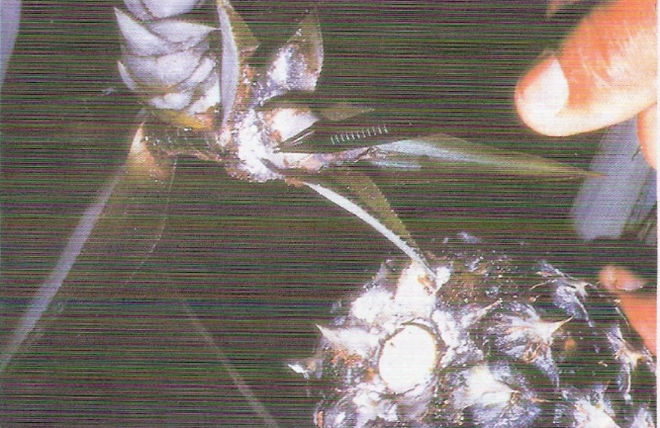
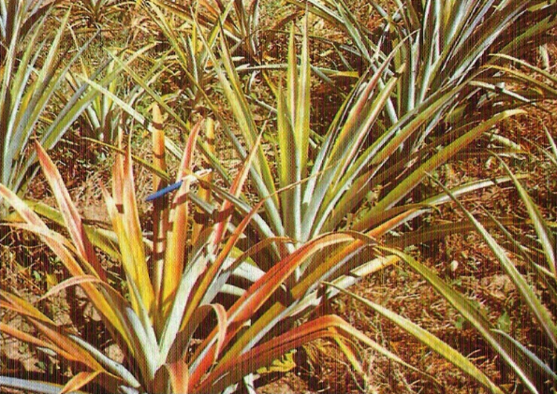
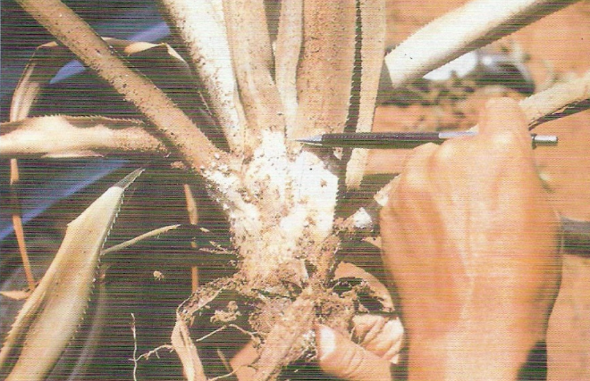
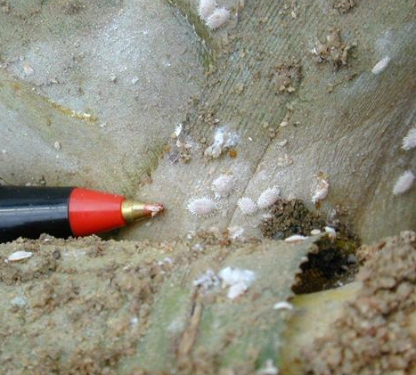
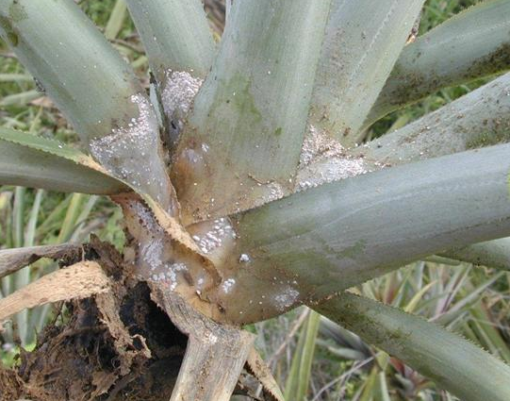
Pragas e doenças
Cultura do abacaxi
Brasil;
Cochonilha do abacaxi
(Dismicoccus brevipes);
Nutricional;
Mundo;
Industria;
Cuidados.

Slide 14
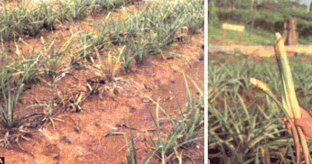
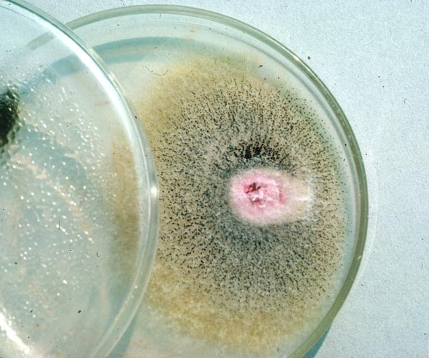
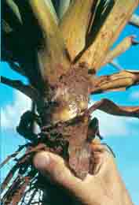
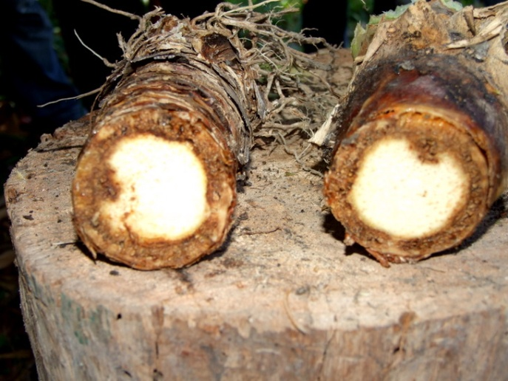
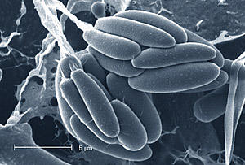
Pragas e doenças
Cultura do abacaxi
Brasil;
Fusariose do abacaxizeiro
(Fusarium subglutinas);
Nutricional;
Mundo;
Industria;
Cuidados.

Slide 15
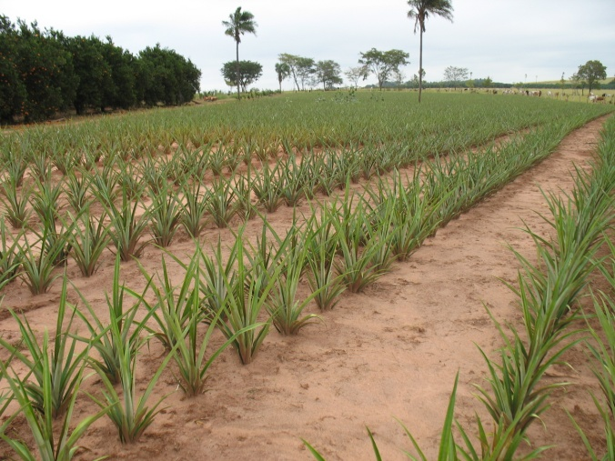
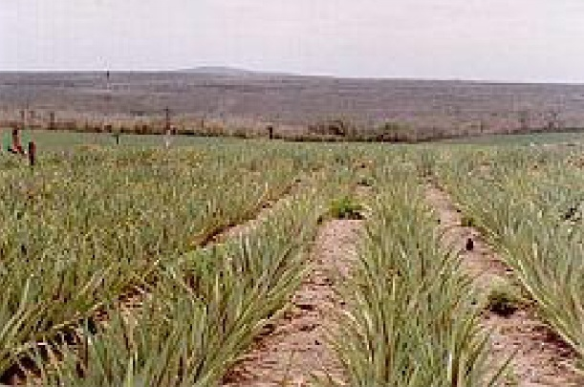
Plantas invasoras
Cultura do abacaxi
Brasil;
Controle de ervas daninhas;
Manual;
Mecânico;
Químico;
Cultural;
Nutricional;
Mundo;
Industria;
Cuidados.

Slide 16
Indução a floração
Cultura do abacaxi
Uniformizar a frutificação;
Ethephon (ácido 2-cloroetil
fosfônico);
2% de uréia;
Carbureto de cálcio;
Brasil;
Nutricional;
Mundo;
Industria;
Cuidados.

Slide 17
Irrigação
Cultura do abacaxi
Brasil;
Desenvolvimento da planta;
120 milímetros mensais;
Aspersão, pivô central, e
autopropelido;
Micro aspersão e
gotejamento;
Nutricional;
Mundo;
Industria;
Cuidados.

Slide 18
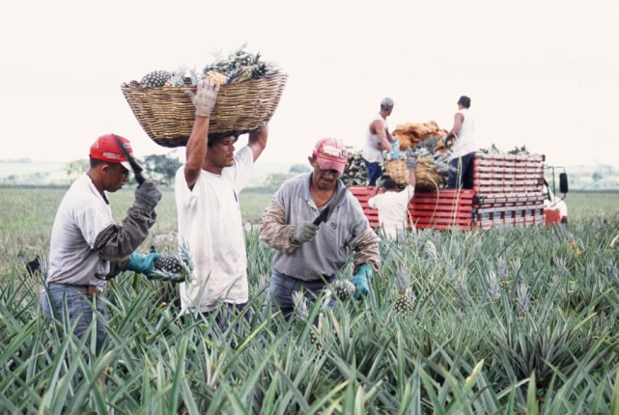
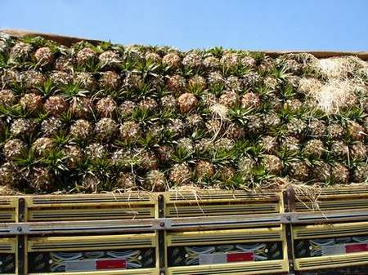
Colheita
Cultura do abacaxi
Pendências alguns fatores;
Brasil;
Transporte;
Tamanho;
Brasil;
Nutricional;
Mundo;
Industria;
Cuidados.

Slide 19


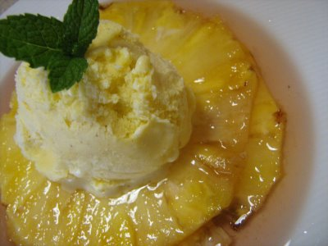
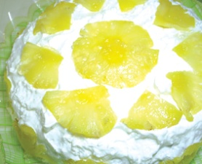


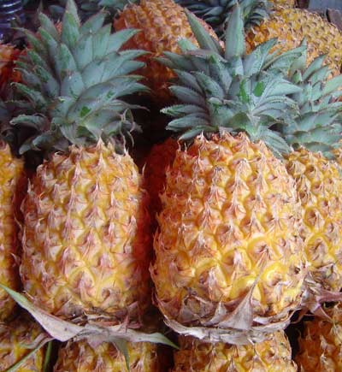

Comercialização
Cultura do abacaxi
Mercado interno e
exportação;
Brasil;
Nutricional;
Mundo;
Industria;
Cuidados.

Slide 20
Considerações finais
Cultura do abacaxi
Brasil;
Elaborarando
Nutricional;
Mundo;
Industria;
Cuidados.

Slide 21
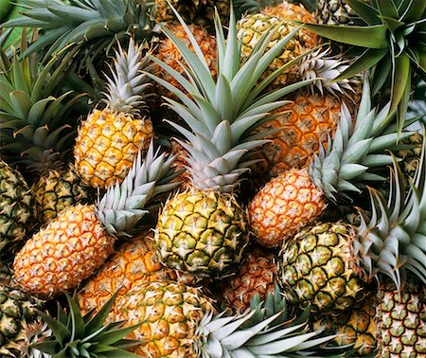
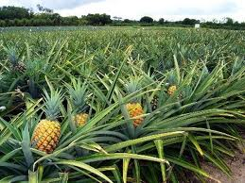
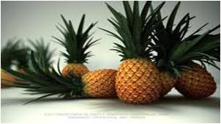
Cultura do abacaxi
Obrigado
Pela
Atenção
Notes:
Custom animation effects: Shrink and position circular pictures
(Intermediate)
Tip: This slide design includes three large, circle-shaped pictures. Each picture has a 12” diameter and is larger than the slide. You will want to use drawing guides to reproduce the effects on this slide.
To display and set the drawing guides, do the following:
On the Home tab, in the Slides group, click Layout, and then click Blank.
On the View tab, in the Show/Hide group, select Ruler.
Right-click the slide background and select Grid and Guides. In the Grid and Guides dialog box, under Guide settings, select Display drawing guides on screen. (Note: One horizontal and one vertical guide will display on the slide at 0.00, the default position. As you drag the guides, the cursor will display the new position.)
Do the following on the slide:
Press and hold CTRL, select the vertical guide, and then drag it left to the 2.83 position.
Press and hold CTRL, select the vertical guide, and then drag it right to the 2.83 position.
Press and hold CTRL, select the horizontal guide, and then drag it up to the 0.83 position.
To reproduce the first animated picture effect on this slide, do the following:
On the Insert tab, in the Illustrations group, click Picture. In the Insert Picture dialog box, select a picture and then click Insert.
On the slide, select the picture. Under Picture Tools, on the Format tab, in the Picture Styles group, click Picture Shape, and then under Basic Shapes click Oval (first row, first option from the left).
Select the oval picture. Under Picture Tools, on the Format tab, in the bottom right corner of the Size group, click the Size and Position dialog box launcher. In the Size and Position dialog box, on the Size tab, resize or crop the picture as needed so that under Size and rotate, the Height box is set to 12” and the Width box is set to 12”. Resize the picture under Size and rotate by entering values into the Height and Width boxes. Crop the picture under Crop from by entering values into the Left, Right, Top, and Bottom boxes.
On the Home tab, in the Drawing group, click Arrange, point to Align, and then do the following:
Click Align to Slide.
Click Align Center.
Click Align Middle.
On the Animations tab, in the Animations group, click Custom Animation.
On the slide, select the picture. In the Custom Animation task pane, do the following:
Click Add Effect, point to Entrance, and then click More Effects. In the Add Entrance Effect dialog box, under Subtle, click Fade, and then click OK. Under Modify: Fade, do the following:
In the Start list, select With Previous.
In the Speed list, select Medium.
Click Add Effect, point to Emphasis, and then click More Effects. In the Add Emphasis Effect dialog box, under Basic, click Grow/Shrink, and then click OK. Under Modify: Grow/Shrink, do the following:
In the Start list, select After Previous.
In the Size list, in the Custom box, enter 20%, and then press ENTER.
In the Speed list, select Medium.
Click Add Effect, point to Motion Paths, and then click Left. Under Modify: Left, do the following:
In the Start list, select With Previous.
In the Speed list, select Medium.
In the Custom Animation task pane, select the third animation effect (left motion path for the first picture). On the slide, select the left motion path. Point to the endpoint (red arrow) of the selected motion path until the cursor becomes a two-headed arrow. Drag the endpoint to the intersection of the drawing guides in the upper left area of the slide (2.83 vertical left and 0.83 horizontal top).
To reproduce the second animated picture effect on this slide, do the following:
On the Insert tab, in the Illustrations group, click Picture. In the Insert Picture dialog box, select a picture and then click Insert.
On the slide, select the picture. Under Picture Tools, on the Format tab, in the Picture Styles group, click Picture Shape, and then under Basic Shapes click Oval (first row, first option from the left).
Select the oval picture. Under Picture Tools, on the Format tab, in the bottom right corner of the Size group, click the Size and Position dialog box launcher. In the Size and Position dialog box, on the Size tab, resize or crop the picture as needed so that under Size and rotate, the Height box is set to 12” and the Width box is set to 12”. Resize the picture under Size and rotate by entering values into the Height and Width boxes. Crop the picture under Crop from by entering values into the Left, Right, Top, and Bottom boxes.
On the Home tab, in the Drawing group, click Arrange, point to Align, and then do the following:
Click Align to Slide.
Click Align Center.
Click Align Middle.
On the Animations tab, in the Animations group, click Custom Animation.
On the slide, select the picture. In the Custom Animation task pane, do the following:
Click Add Effect, point to Entrance, and then click More Effects. In the Add Entrance Effect dialog box, under Subtle, click Fade, and then click OK. Under Modify: Fade, do the following:
In the Start list, select With Previous.
In the Speed list, select Medium.
Click Add Effect, point to Emphasis, and then click More Effects. In the Add Emphasis Effect dialog box, under Basic, click Grow/Shrink, and then click OK. Under Modify: Grow/Shrink, do the following:
In the Start list, select After Previous.
In the Size list, in the Custom box, enter 20%, and then press ENTER.
In the Speed list, select Medium.
Click Add Effect, point to Motion Paths, and then click Up. Under Modify: Up, do the following:
In the Start list, select With Previous.
In the Speed list, select Medium.
In the Custom Animation task pane, select the sixth animation effect (up motion path for the second picture). On the slide, point to the endpoint (red arrow) of the selected motion path until the cursor becomes a two-headed arrow. Drag the endpoint to the intersection of the drawing guides in the upper middle area of the slide (0.00 vertical and 0.83 horizontal top).
To reproduce the third animated picture effect on this slide, do the following:
On the Insert tab, in the Illustrations group, click Picture. In the Insert Picture dialog box, select a picture and then click Insert.
On the slide, select the picture. Under Picture Tools, on the Format tab, in the Picture Styles group, click Picture Shape, and then under Basic Shapes click Oval (first row, first option from the left).
Select the oval picture. Under Picture Tools, on the Format tab, in the bottom right corner of the Size group, click the Size and Position dialog box launcher. In the Size and Position dialog box, on the Size tab, resize or crop the picture as needed so that under Size and rotate, the Height box is set to 12” and the Width box is set to 12”. Resize the picture under Size and rotate by entering values into the Height and Width boxes. Crop the picture under Crop from by entering values into the Left, Right, Top, and Bottom boxes.
On the Home tab, in the Drawing group, click Arrange, point to Align, and then do the following:
Click Align to Slide.
Click Align Center.
Click Align Middle.
On the Animations tab, in the Animations group, click Custom Animation.
On the slide, select the picture. In the Custom Animation task pane, do the following:
Click Add Effect, point to Entrance, and then click More Effects. In the Add Entrance Effect dialog box, under Subtle, click Fade, and then click OK. Under Modify: Fade, do the following:
In the Start list, select With Previous.
In the Speed list, select Medium.
Click Add Effect, point to Emphasis, and then click More Effects. In the Add Emphasis Effect dialog box, under Basic, click Grow/Shrink, and then click OK. Under Modify: Grow/Shrink, do the following:
In the Start list, select After Previous.
In the Size list, in the Custom box, enter 20%, and then press ENTER.
In the Speed list, select Medium.
Click Add Effect, point to Motion Paths, and then click Right. Under Modify: Right, do the following:
In the Start list, select With Previous.
In the Speed list, select Medium.
In the Custom Animation task pane, select the ninth animation effect (right motion path for the third picture). On the slide, point to the endpoint (red arrow) of the selected motion path until the cursor becomes a two-headed arrow. Drag the endpoint to the intersection of the drawing guides in the upper right area of the slide (0.83 horizontal top and 2.83 vertical right).
To reproduce the animated text effects on this slide, do the following:
On the Insert tab, in the Text group, click Text Box. On the slide, drag to draw a text box.
Enter text in the text box, and then select the text. On the Home tab, in the Font group, select Candara from the Font list, select 24 from the Font Size list, click the arrow next to Font Color, and then under Theme Colors click White, Background 1 (first row, first option from the left).
On the Home tab, in the Paragraph group, click Center.
On the slide, select the text box. On the Home tab, in the Clipboard group, click the arrow under Paste, and then click Duplicate. Repeat this process once more for a total of three text boxes.
Click in the duplicate text boxes, and then edit the text.
Select the first text box, and then drag it on the slide so that it is centered on the left vertical drawing guide at 2.83 and below the horizontal drawing guide at 0.00.
Select the second text box, and then drag it on the slide so that it is centered on the vertical drawing guide at 0.00 and below the horizontal drawing guide at 0.00.
Select the third text box, and then drag it on the slide so that it is centered on the right vertical drawing guide at 2.83 and below the horizontal drawing guide at 0.00.
On the slide, select the first (left) text box. In the Custom Animation task pane, do the following:
Click Add Effect, point to Entrance, and then click More Effects. In the Add Entrance Effect dialog box, under Moderate, click Descend, and then click OK.
Under Modify: Descend, in the Start list, select With Previous.
Under Modify: Descend, in the Speed list, select Fast.
Also in the Custom Animation task pane, click the arrow to the right of the 10th animation effect (descend effect for the first text box), and then click Timing. In the Descend dialog box, on the Timing tab, in the Delay box, enter 2, and then click OK.
On the slide, select the second (center) text box. In the Custom Animation task pane, do the following:
Click Add Effect, point to Entrance, and then click More Effects. In the Add Entrance Effect dialog box, under Moderate, click Descend, and then click OK.
Under Modify: Descend, in the Start list, select With Previous.
Under Modify: Descend, in the Speed list, select Fast.
Also in the Custom Animation task pane, click the arrow to the right of the 10th animation effect (descend effect for the first text box), and then click Timing. In the Descend dialog box, on the Timing tab, in the Delay box, enter 3, and then click OK.
On the slide, select the third (right) text box. In the Custom Animation task pane, do the following:
Click Add Effect, point to Entrance, and then click More Effects. In the Add Entrance Effect dialog box, under Moderate, click Descend, and then click OK.
Under Modify: Descend, in the Start list, select With Previous.
Under Modify: Descend, in the Speed list, select Fast.
Also in the Custom Animation task pane, click the arrow to the right of the 10th animation effect (descend effect for the first text box), and then click Timing. In the Descend dialog box, on the Timing tab, in the Delay box, enter 4, and then click OK.
To reproduce the background effects on this slide, do the following:
On the Design tab, in the bottom right corner of the Background group, click the Format Background dialog box launcher. In the Format Background dialog box, in the left pane, click Fill. In the Fill pane, click Picture or text fill, and then under Insert From, click File. In the Insert Picture dialog box, select a picture and then click Insert.
Also the Format Background dialog box, in the left pane, click Picture. In the Picture pane, click the button next to Recolor, and then under Color Modes click Grayscale (first option from the left).

